Slide 1

Town of Holland
Comprehensive plan
Open House February 2021

Slide 2
Introduction
What is a comprehensive plan?
Who is working on the plan?
What is your role in the planning process?

Slide 3
What is a Comprehensive Plan?
Process that determines community goals and aspirations leading to community development
Manages anticipated growth in a community
Create policies and initiatives essential elements
Guides decision making for all stakeholders on current and future land use
Is required by the State to be updated every 10 years

Slide 4
Why do we need a Comprehensive Plan?
Guide future development and/or redevelopment of land
Provide a legal basis for zoning and other regulations
Identifies issues and opportunities within the community
Engages the public with policy decisions
Collects data to understand the current and future conditions of a community

Slide 5
What the planning process looks like
Initial committee meeting reviews old plan
Research and analysis on elements
Community involvement in planning goals and land use changes
Review of draft plan
Final draft with a public hearing, adoption

Slide 6


Who is working on the Plan?
Town of Holland Plan Commission
Town of Holland Town Board
Mississippi River Regional Planning Commission

Slide 7








Comprehensive Plan Elements
Housing
Transportation
Utilities and Community Facilities
Agricultural, Natural, and Cultural Resources
Economic Development
Intergovernmental Cooperation
Land Use
Implementation

Slide 8
Purpose of the Open House
Gather public input
Evaluate ideas from the Plan Commission
Collaborate on planning goals
Review of draft plan
Add suggestions from the public to the plan

Slide 9
The Process

Slide 10

Housing
Assess the current housing stock
  Cost and availability of housing
Identify development areas
Create new strategies for housing developments
Goals:
The Town of Holland will contain a variety of quality housing choices for all residents, including different age, income, and special needs.
The Town of Holland will preserve natural features in new housing developments.
The Town will not be financially burdened by new residential development.
Are there additional housing goals you would you like to see included?

Slide 11

Transportation
Identify daily mobility needs in community
Identify gaps in transportation system
Evaluate opportunities for non-motorized modes of transportation
Goals:
The Town of Holland will work with La Crosse County and neighboring jurisdictions to provide a safe, efficient and economically sound transportation system that meets the needs of all its residents, businesses and visitors.
The Town’s transportation system will be designed to protect the rural character of the Town and minimize impacts on the natural environment to the greatest extent possible.
Enhance connectivity within the Town with multi-use trails.
How can we improve transportation opportunities in the Town of Holland?

Slide 12
Utilities and Community Facilities
Goals:
1. Ensure Town residents and businesses are adequately served by desired public utilities and facilities in a cost-effective way and in a manner that promotes a high quality of life.
2. Avoid environmentally sensitive areas when extending and constructing new utilities and community facilities.
3. Continue to provide and improve outdoor recreational facilities for active uses (e.g. ball games) and natural areas for passive uses (e.g., birdwatching).
4. Work with surrounding municipalities on extending the range and scope of local service provision, especially municipal water or sewer services.
5. Regionalize fire and EMS services in the area.
Assess community access to utilities and community facilities
Determine maintenance or enhancement of facilities
Identify current systems and contracts in place
Run a capacity analysis to determine current and future needs
What services do you feel need improvement?

Slide 13
Agricultural, natural, and cultural resources
Inventory existing facilities
Provide recommendations on preservation or enhancements on existing facilities
Promote multi-use facilities
Goals:
1. Preserve the Town of Holland’s agricultural resources - including productive agricultural land, waterways, groundwater, and woodlands – for this and future generations.
2. Enhance public access, use and enjoyment of the community’s natural and recreational resources.
3. Preserve the Town of Holland’s natural resources - including productive agricultural land, the bluffs, prairies, scenic views, waterways, wetlands, woodlands and wildlife habitat – for this and future generations.
4. Identify, conserve and protect the Town’s cultural, historical and archaeological resources.
What would you add to this list of goals?

Slide 14
Economic Development
Identify potential industrial and commercial redevelopment areas
Evaluate current and future industry opportunities
Work with regional and local economic development partners
Goals:
1. Encourage economic opportunities that enhance the quality of life for Town residents, are appropriate for the levels of public services and facilities in the Town and are environmentally sensitive.
2. Encourage economic development that supports agriculture and serves Town residents and visitors.
What is your vision for economic development in the Town of Holland?

Slide 15
Intergovernmental Cooperation
Partner with local interest groups to promote wellbeing of community
Solve mutual problems with local entities
Identify potential cost saving service agreements with outside entities
Goals:
1. The Town will maintain good relationships with governmental units in and around the region.
2. Participate in regional planning efforts and coordinate all planning activities with neighboring communities and La Crosse County.
3. Coordinate with neighboring communities and La Crosse County to provide high quality services in the most cost-effective manner possible.
What cooperative relationships, in the Town, would you like to see maintained or grow in the next 10 years?

Slide 16
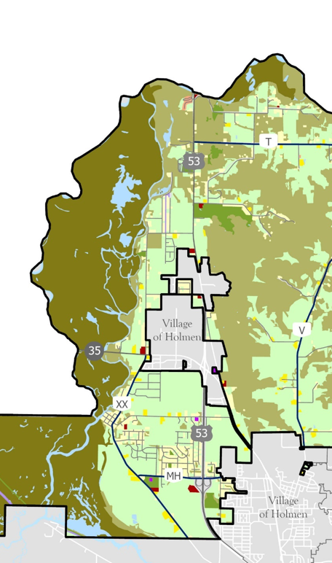
Land Use
What goals would you include to guide land use and development?
Determine current land use trends
Use goals to identify future land use
Develop a future land use map to guide growth and development (Open House #2)
Goals:
1. Control and direct new development to locations that are appropriate for development, as described within the context of this document.
2. Increase the sustainability of new development through appropriate siting and design. Ensure that new development is consistent with the Town’s ability to provide cost-effective infrastructure and services both at the time the development occurs and in the long-term.

Slide 17
Implementation
Create action steps to achieve goals outlined in Plan
Refer to document when making planning decisions

Slide 18
Thank you!
Please submit your questions and comments to the plan website or
email link below.
https://town-of-campbell-mrrpc.hub.arcgis.com/
Abbey Nicewander
Senior Planner, Mississippi River Regional Planning Commission
abbey@mrrpc.com

